Slide 1


SEER A Real-Time Pedestrian Detection and Tracking System for Intelligent Vehicles

Slide 2
Architecture Progress Report
CONTENTS
Overview
Phase 2
ITS
IoV and VANET
Comparison of IoV and VANET
Communication technologies in IoV
Safety metrics
Phase 3
Physical architecture
System networking
Logical designs
Workflow
System prototype specification
Work Status
What's Next
Queries

Slide 3




Overview
Phase 1
Phase 3
Phase 5
Analyze Functionality
Architecture Design
Integration & Testing
Brief Idea of Project
Comprehensive requirement analysis
Network Architechture
Layered Communication
Logical Architecture
Prototyping (UI design) – sitemap, userflow and wireframes
Integrate frontend with backend and ML
Integrate admin functions
Test webapp for mobile layout
Literature Survey
Development
Deployment
How Does It Work?
Safety & Communication
Architecture & Networking
Components for Prototype
Interface Development (Websocket)
User Interface development (Angular)
Admin modules (Network OAM – Nagios & Zoneminder)
Deploy Application
Phase 2
Phase 4
Phase 6

Slide 4
PHASE 2
Survey components to determine a working prototype
Survey existing concepts of Intelligent Transportation System
Gather information about communication techniques employed in IoV
Identify safety metrics and communication latency to meet safety requirements

Slide 5
Intelligent Transportation System (ITS)
ITS is a system which employs state of the art technologies to enhance traffic management, mode of transport and to provide smart services which improve drivers’ experience.
Advantages of ITS:
Human intervention can be reduced by automating routine activities that do not need human supervision.
Real-time monitoring of road network performance can be achieved.
The goal of ITS can be realised by the following concepts:
Vehicular Ad-hoc Networks (VANETs)
Internet of Vehicles (IoV)

Slide 6
IoV and VANET
VANET: VANET is an infrastructure-less ad hoc network in which the node can be a Roadside Unit(RSU) or a moving vehicle. It establishes and maintains a communication network without the help of any controller.
IOV: IoV is a distributed network which enables the use of data created by VANETs and connected vehicles on the network. The main goal of IoV is to allow real-time communication between vehicles and different components (human, thing, environment) on the network.

Slide 7
IoV (Contd..) The main goal of IoV is to realize in-depth integration of human, vehicle, thing, environment to improve efficiency of transportation.
Layer
Functionality
Perception
Coordination/Network
Artificial Intelligence
Application
Business
Data Gathering: Crosswalk Camera feed, position & speed of vehicles
Day/Night perception
Secure Transmission of information
Inter-operability provision between different networks
Processing and analysis of data
Analysis based decision making (pedestrian detection/tracking
Smart services to end users
Response to Vehicle control unit (VCU)
Monitor resource usage
Strategical planning

Slide 8
Comparison of VANETs and IoV
VANETs | IoV
Traffic safety to avoid causalities and to enhance traffic effectiveness | Enhancing traffic safety, effectiveness and commercial infotainment for passengers to enhance the driving experience
Two kinds of communication- •Vehicle-to-vehicle (V2V) •Vehicle-to-infrastructures (V2I) | Five kinds of communication- •Vehicle-to-Vehicle (V2V) •Vehicle-to-Road Side Units (V2R) •Vehicle-to-Infrastructure of Cellular Networks (V2I) •Vehicle-to-Sensors (V2S) •Vehicle-to-Personal Devices (V2P)
Not compatible with personal devices like smartphones, tablets, laptops etc. due to singleton network architecture | Effective communication is possible between vehicles and network due to compatibility with personal devices
Range is local and discrete. Suitable for limited scale applications | Global scope and sustainable applications due to the incorporation of vehicle networking with vehicle intelligence

Slide 9
Communication Technologies in IoV
DSRC: Dedicated Short-Range Communication is a two-way short-to-medium range wireless communication technology that enables vehicles to communicate with each other and other road users directly, without involving cellular or other infrastructure. It operates on 5.9 GHz band of radio frequency spectrum and has low latency, high reliability.
Cellular: LTE has been proposed as a viable technology for vehicular machine-to-machine communication because of its high data rate, low latency and large coverage. 5G can support up to a million devices per square kilometre, as opposed to 4G supporting only up to 100,000 devices per sq. Km.

Slide 10
Communication Techniques (Contd..)
Parameters | 802.11p | V2X communication | Comments
Technology | Dedicated Short-Range Communication (DSRC) | Cellular (LTE, PC5 interface)
Low Latency | 2 ms | 14-4ms (Release 14/15) <=1ms (Release 16)
Connection Path | Direct only | Both Direct and Network
Range | 300m(1000m max) | 300 m (PC5 interface) 30 km (LTE) | Note: 1000 ft(5G)
Bandwidth | 6-27Mbps, | 15-30 Mbps (PC5) LTE-150MPs (Uu interface) | Note: 6400Mbps(5G)
Stability | Lower | Higher
Transmission Cost | Lower | Higher
Connection Path | Direct only | Both Direct and Network
End user Access | On OBU kit only | Both Smartphone and OBU
Synchronization | Asynchronous | Synchronous | Spectral Efficiency. Synchronization enables time division multiplexing (TDM) and lowers channel access overhead.
Waveform | Orthogonal frequency-division multiplexing (OFDM) | Single carrier frequency division multiple access (SC-FDM)
Can operate in ITS 5.9 GHz spectrum | Yes | Yes
Coexistence in 5.9Ghz | Yes | Yes (Release 14 onwards)
Resource selection | Carrier sense multiple access with collision avoidance (CSMA-CA) | Semi persistent transmission with relative energy-based selection
Resource multiplexing | TDM only | FDM and TDM possible | Frequency Division Multiplexing allows for larger link budget and therefore longer range - or more reliable performance at the same range
Retransmission technique | No HARQ | Hybrid automatic repeat request (HARQ) | Leads to longer range - or more reliable performance at the same range.
Waveform | SC-FDM | OFDM | Allows for more transmit power with the same power amplifier. Leads to longer range + more reliable performance at the same range.
Channel coding | Conventional | Turbo | Coding gain from turbo codes leads to longer range - or more reliable performance at the same range.
Note:
As per research paper “Valérian Mannoni, Vincent Berg, Stefania Sesia, Eric Perraud. A Comparison of the V2X Communication Systems: ITS-G5 and C-V2X. IEEE Vehicular Technology Conference (VTC) Spring 2019, Apr 2019, Kuala-Lumpur, Malaysia. cea-02183828”:
CV2X has greater flexiblity.
Overall CV2X had better performance than ITS-G5.
The wide variety of parameterization of the C-V2X allows to accentuate this gain with an improvement of the communication range, particularly when retransmission is considered.
Simulations showed that C-V2X outperforms ITS-G5 when the user density is inferior to 150 users=km2. However, C-V2X performance deteriorates more severely than ITS-G5 when the level of congestion increases.
The latency, which is another important indicator for V2X scenarios was also derived. The resource access duration comparison gives an advantage to the ITS-G5, however the overall latency is not clearly better for one system because it is highly dependent on user density and operating range.

Slide 11
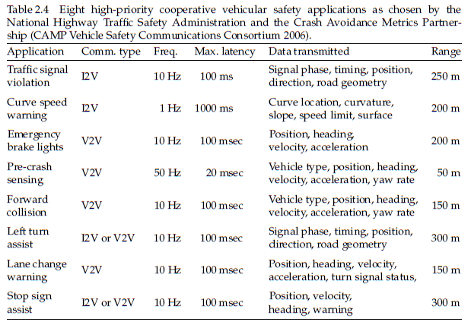
Safety Metrics
Note: As per safety application metrics of CAMP vehicle safety communication consortiums, 2006. To avoid any kind of collision the range for detection lies between 50m to 150m and the latency for communication channel should be between 20 to 100ms.

Slide 12
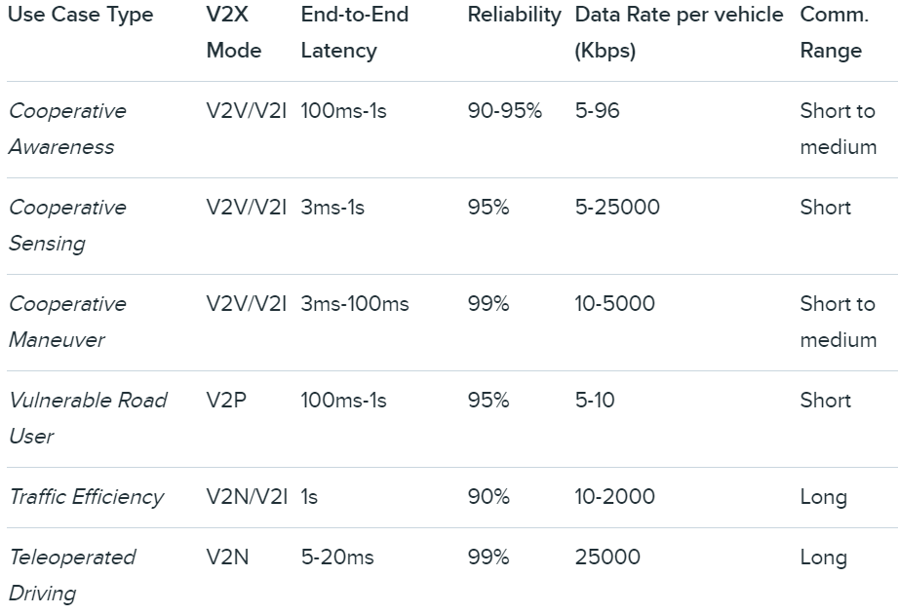
Safety Metrics Contd…
Note: Use case scenario by Qualcomm [7], shows that in most V2X applications the best metric for: latency is around 3ms and the reliability is in order > 90%.

Slide 13
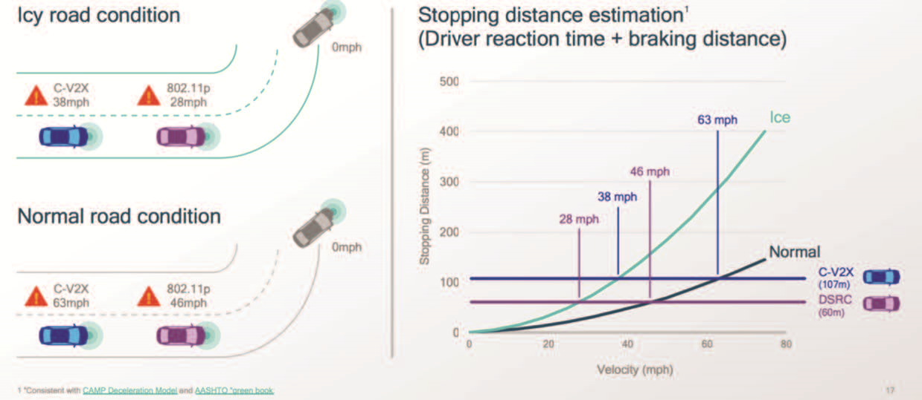
Safety Metrics Contd…
Note: As per Qualcomm. Stopping distance estimation lies between range of 60m to 107m, which can vary depending on the road conditions from normal to Icy

Slide 14
PHASE 3
Design workflow of project
Conceptualize architectural design of the project
Explore internetworking of components
Identify logical architectures and compare their computational advantages

Slide 15
Physical Architecture
Application Server
System Components
Infrastructure: The infrastructure consists of Network Switches/routers, eNBs, RSUs and Pedestrian Detection units (PDUs).
On-Board Units (OBUs) / Smartphones: Smartphones and vehicle’s On-Board Unit (OBU) can both be regarded as clients. Smartphones can connect to both C-V2X based RSU and cellular network through LTE network, while vehicle’s OBU can only connect to RSU through DSRC technology and other vehicles through DSRC.
Application server: Application server aggregates data from vehicles and camera, to predict and track pedestrian on crosswalk. Services can be served both in centralized and distributed approaches. In addition to decision making tasks, application server will have node manageability capabilities, authentication and admin control.
Internet Cloud
V2C
Pedestrian Detection Unit
RSU
V2I
OBU/ Smartphone

Slide 16
System Networking
Application Layer
Application Server
Legends
Logical connection - - - - - - - Ethernet ------------ Wireless - - - - - - -
Aggregation Layer
Cloud
ISP Network
Access Layer
Switch/Router
Pedestrian Detection Unit
RSU
IP Camera
Wireless Link
OBU/ SmartPhone
Network Layers
Access layer: All users/smart vehicles that can initiate service request and other access devices like RSU and IP camera connected to network are in access layer. Service creation and termination execute in this layer.
Aggregation layer: Multiple eNBs and RSUs from access network are connected to their respective ISP Network or Cellular Backhaul to access Internet. Data from multiple nodes are aggregated in this layer and transferred to core application.
Application layer: Central node i.e. Application server is part of Application layer. Network monitoring and service scheduling can be processed on Application servers in this layer.

Slide 17

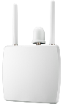
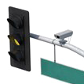

Access Layer Communication
The communication link based on cellular technology is more stable than that on DSRC. The DSRC based RSU have smaller transmission range than one with equipped for eNB, but it provides data rate at lower cost transmission.
Cellular Backhaul
C-V2X
eNB
Switch/Router
Pedestrian Detection unit
DSRC
RSU
Pedestrian Detection unit
Uu
Uu
RSU
PC5
Camera
802.11p
Camera
Smartphone

Slide 18
Logical Designs
Centralized
Distributed
Hybrid

Slide 19
Centralized Design
Server
Data Preprocessing
Object
Detection
Receive Data from RSU
Decision Making & Response Generation
Classification
Tracking
Send Response to RSU
Node Manageblity /Access Control
RSU
Send Acquired Data from Detection Unit
Receive Response from Detection Unit
Receive request from vehicle
‘Send response to vehicle
IP Camera
OBU/ SmartPhone
Send Vehicle Data( Speed and Coordinates)
Receive response from RSU
Establish Connection with RSU

Slide 20
Distributed Design
Detection Unit
Data Acquisition from Camera
Data Preprocessing
Object
Detection
Classification
Tracking
Decision Making & Response Generation
IP Camera
Server
Receive Data from RSU
Send Response to RSU
Node Manageblity /Access Control
RSU
Send Acquired Data from Detection Unit
Receive Response from Detection Unit
Receive request from vehice
‘Send response to vehicle
OBU/ SmartPhone
Send Vehicle Data( Speed and Coordinates)
Receive response from RSU
Establish Connection with RSU

Slide 21
Hybrid Design
Detection Unit
Data Acquisition from Camera
Data Preprocessing
Object
Detection
Classification
Tracking
Decision Making & Response Generation
Server
IP Camera
Data Preprocessing
Object
Detection
Receive Data from RSU
Decision Making & Response Generation
Classification
Tracking
Send Response to RSU
Node Manageblity /Access Control
RSU
Send Acquired Data from Detection Unit
Receive Response from Detection Unit
Receive request from vehice
‘Send response to vehicle
OBU/ SmartPhone
Send Vehicle Data( Speed and Coordinates)
Receive response from RSU
Establish Connection with RSU

Slide 22
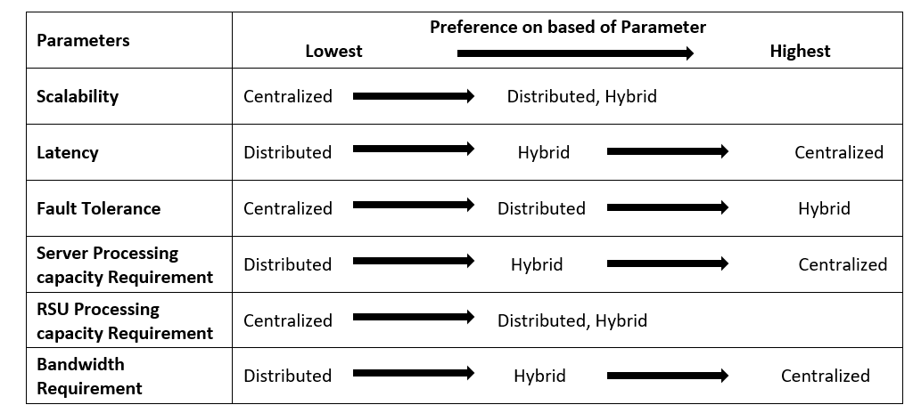
Logical Design (Contd….) Comparison

Slide 23



Workflow
01
03
Stage 1
Stage 3
02
User Initiates Request &
Establish communication
Sending Response
Running ML (Detection) Models and generating response
Stage 2

Slide 24
Workflow Continued..
01
Establishing communication
Stage 1

Slide 25
Workflow Continued..
02
Running ML (Detection) Models and generating response
Stage 3

Slide 26
Workflow Continued..
03
Sending Response
Stage 3

Slide 27
System Prototype specification
 | Jevois A33 | Raspberry Pi 4B | Nvidia Nano
AI Performance |  |  | 472 GFlops
CPU | Allwinner A33 core ARM Cortex A7 | 64-bit Quad ARM v8 Cortex-A72 | 64 bit quad ARM Cortex A57
Clock | 1.34GHz | 1.5 | 1.4Ghz
GPU | dual core Mali-400 GPU supporting OpenGL-ES 2.0. | OpenGL ES 3.0 graphics | 128 core Nvidia Maxwell
ML Accelerator | None | None | None
RAM | 256MB DDR3 SDRAM | 1GB, 2GB or 4GB | 4GB
Storage | microSD for firmware, Linux OS, machine vision software(25Mbps)
GPIO for camera | NA | 40 Pin | 40 Pin
Camera | 1.3MP, SXGA (1024) @ 15 fps, VGA (480) @ 30 fps, CIF (288) @ 60 fps | Custom Camera: 8MP Raspberry Pi camera V2 - USD 30 5MP Arducam/NOIR/Hiletgo camera with IR LED set - USD 20, 1080 p @ 30 fps, 720 p @ 60 fps
Ports | USB 2.0, Serial (5V or 3.3V) | 2 USB 3.0 ports; 2 USB 2.0 ports | 4xUSB 3.0,
Connectivity |  | Wifi (2.4/5.0 GHz), Bluetooth 5.0, GB ETH | GB ETH
Boot Time | 5s | 33s
Power consumption | 3.5W | 3.75W
CPU temp | 71C | 50C
Performance | Max 70fps@320x240, no dropped frames at 60fps
Size | 28cc | 88cc
Price | USD 49 | Approx. USD 60 + USD 30 (camera) | USD 99 + USD 30 (camera)
Pros | smallest TensorFlow-enabled deep learning edge AI smart camera for IoT, computer vision
Cons | Lower processing capabilities | Medium processing capabilities | Highest processing capabilities

Slide 28
CURRENT STATUS
Further Timeline
Phase 5
Integration & Testing
Phase 4 Development
Phase 3 Architecture Design
100%
Phase 2 Survey
95%
Feb 6 -
Phase 1 Inception
100%
Feb 6
JAN
FEB
MAR
APR
MAY
JUN
PROJECT START
PROJECT FINISHES
Quarter goals description
Quarter goals description

Slide 29
What’s Next?
Started implementing ML models on dummy dataset for -Detecting Pedestrians -Counting Pedestrians
Start implementation of client – server architecture

Slide 30
Queries
Given the current situation, it is difficult to physically collaborate. We require supervision/suggestions regarding the following issues:
Data Acquisition – How to acquire dataset (real-time)?
Possibility/Scope of Hardware Implementation (camera + processing unit).

Slide 31
Thank You

